Slide 1
WIX3001 SOFT COMPUTING 2022/23, Semester 2
Liew Wei Shiung
liew.wei.shiung@um.edu.my
019 965 9806
FSKTM B-2-22

Slide 2
Learning Outcomes and Course Content
At the end of the course, students are able to:
Describe soft computing techniques and their roles in building intelligent machines.
Use soft computing tools to solve a particular problem.
Apply soft computing techniques to solve real problems.
This course provides the basis of the theory of soft computing.
The course comprises of computational techniques such as Genetic/Evolutionary Algorithms, Artificial Neural Networks, Fuzzy Logics and Machine Learning.

Slide 3
Assessment Methods
Continuous Assessment: 50%
Individual Assignments.
Weekly Tutorials / Quizzes.
Summative Assessment: 50%
Final exam.
Individual Assignments:
Programming in MATLAB and Python.

Slide 4
Timetable
Updated timetable: https://jw.fsktm.um.edu.my
Lecture
Tuesday: 4pm – 6pm, Dewan Kuliah 1
Tutorials:
Will be conducted by Ms. Fatemeh Shahrzad Ahanin.
Group 1: Thursday 11am – 12pm, MM4.
Group 2: Thursday 12pm – 1pm, MM4.
Group 3: Thursday 3pm – 4pm, MM4.

Slide 5
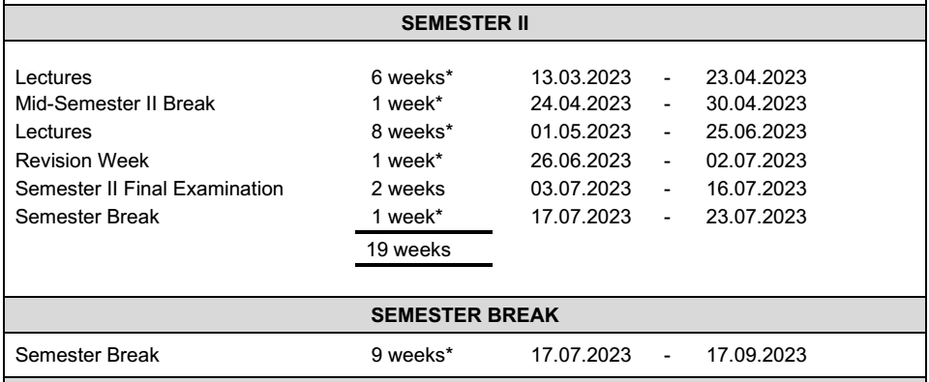
Academic Calendar
Updated calendar at: https://aasd.um.edu.my/academic-calendar

Slide 6
Reference Books
Neural Networks, Fuzzy Logic and Genetic Algorithms: Synthesis & Applications, S. Rajasekaran & G. A. Vijayalakshmi Pai, PHI Learning Pvt. Ltd., 2003.
Principles of Soft Computing, S. N. Sivanandam & S. N. Deepa, Wiley - India, 2007.
Soft Computing and its Application, Aliev, R.A, Aliev, R.R.:, World Scientific Publishing Co. Pte. Ltd., 2001.
Introduction to Soft Computing by Eva Volna.
Concepts of Soft Computing: Fuzzy and ANN with Programming; Authors: Chakraverty, Snehashish, Sahoo, Deepti Moyi, Mahato, Nisha Rani
Soft Computing: Concepts and Techniques, January 2014, by Mrutyunjaya

Slide 7
Programming with MATLAB
Access to MATLAB for UM Students:
https://www.mathworks.com/academia/tah-portal/university-of-malaya-31385608.html
MATLAB Online: https://matlab.mathworks.com/ ; log in with your Siswamail and program in MATLAB using your web browser.
Handy guides for MATLAB:
https://www.mathworks.com/help/matlab/examples.html
https://www.mathworks.com/help/matlab/learn_matlab/matrices-and-arrays.html
https://www.mathworks.com/help/matlab/learn_matlab/array-indexing.html
https://www.mathworks.com/help/matlab/learn_matlab/workspace.html
https://www.mathworks.com/help/matlab/learn_matlab/calling-functions.html
https://www.mathworks.com/help/matlab/learn_matlab/scripts.html

Slide 8
Programming with Python
Anaconda programming environment:
https://www.anaconda.com/products/distribution#Downloads
*make sure the Anaconda version is compatible with your operating system.
Google Colaboratory:
https://colab.research.google.com
Python tutorials:
https://realpython.com/python-ai-neural-network/
https://machinelearningmastery.com/tutorial-first-neural-network-python-keras/
https://www.activestate.com/resources/quick-reads/how-to-create-a-neural-network-in-python-with-and-without-keras/

